Slide 1
Miniature 31 Cutting Cheaply Using Eigenvectors

Slide 2
Agenda
Objective
Process
Application
2-way partition
K-way partition
References

Slide 3
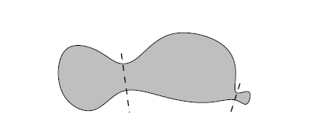
Objective
To partition a connected graph into multiple graphs so that they are connected by least no of edges. It is NP-Hard problem.

Slide 4
Process
Step 1
Adjacency matrix(A) of any given graph
Step2
Calculate the Laplacian(L=D-A) of the adjacency matrix where D is diagonal matrix of degrees
Step3
Estimate the eigenvalues and eigenvectors of the Laplacian matrix(L)
Step 4
Choose the eigenvector(Fiedler vector) corresponding to the second smallest eigenvalue
Step5
Partition the graph based on any chosen metric from the Fiedler vector

Slide 5
Application
Machine Learning -Clustering algorithm
Computer Graphics and Computer Vision -Image split
Finite Element Problems - Domain decomposition of mesh for parallel processing

Slide 6
2 way partition (Fiedler Partition)
In this process, Fiedler vector is split into 2 partitions based on the positive and negative values
Another variant to get balanced graphs is to split the Fiedler vector based on the median value

Slide 7
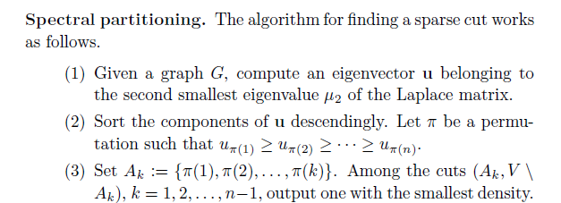
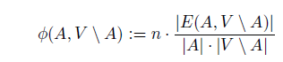
2 way partition (Miniature 31)
Density Metric

Slide 8
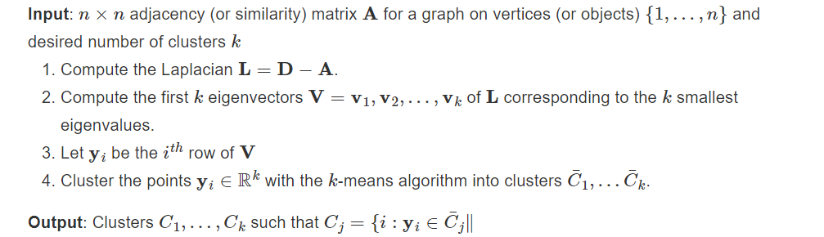
K- way partition (Ratio Cut)
Another variant to get 2^K partitions is to split the graphs recursively

Slide 9
References
https://shainarace.github.io/LinearAlgebra/chap1-5.html
https://wandb.ai/syllogismos/machine-learning-with-graphs/reports/5-Spectral-Clustering--VmlldzozNzcwMDU

Slide 10
Thank you
Gautam GSJ
21f1002129@ds.study.iitm.ac.in

